Slide 1
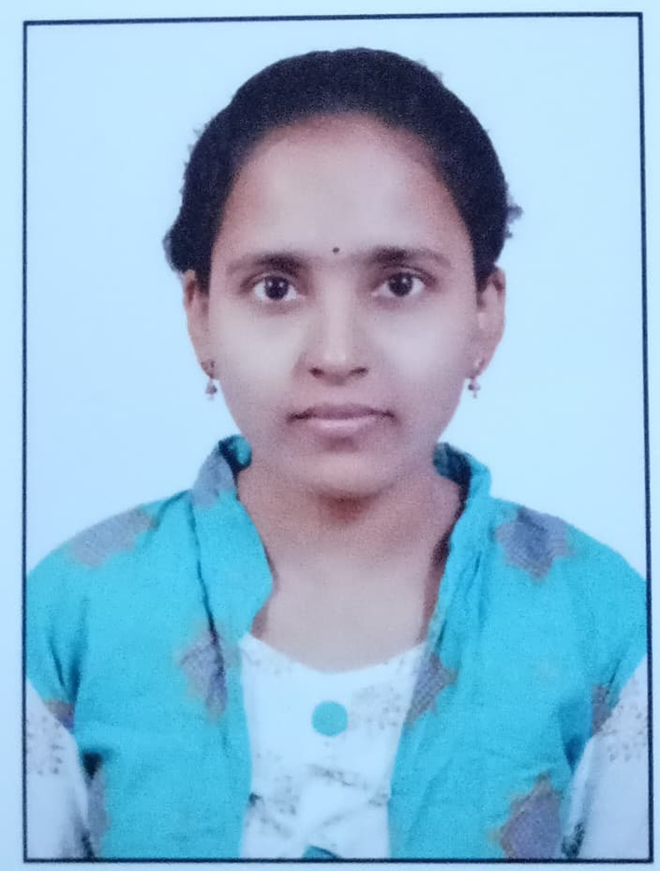


Lakshmi Chapala
Analyst/Software Engineer
Bachelor of Technology Computer Science : 2017 - 2020
Skills
Spring Boot, MVC
Spring Security
JPA CRUD
Bootstrap
MERN Stack
Angular
NodeJS
MongoDB
Database
SQL database – MySQL
No SQL database – MongoDB
Web Technologies
HTML5 & CSS3
Javascript
Typescript
AddOns
Github
Maven
Postman
Additional Details
Leadership
Communication Skills
Team management
Bangalore
Lakshmi.chapala@capgemini.com
+91 8008788483
A4
Software Engineer who is Strong in design and integration with intuitive problem-solving skills. Passionate about implementing and launching new projects.
Ready to learn new technologies and implement them to further improve my knowledge.
Eager to work in a team of dedicated people and serve a key role in the enhancement and development of the project.
Has working knowledge on ReactJS(Hooks, redux)and Java Microservice Development using Spring framework on an intermediate level.
1. Deals and Coupons Finder App Web Application
Completed end to end case study of Deals and Coupons Finder App along with JWT authentication, Swagger and payment testing using Spring Boot and MERN Stack. Material-UI and Bootstrap used for user interface.
2. Backend (MongoDB), Midware (Spring Boot) and Frontend (Angular) at Capgemini Degreed Platform
Learned and recompiled all concepts of the backend, midware and frontend to polish my skills to work on real –time projects.
Check out my work on GitHub & Video Profile

